Slide 1


Tis the Season for Big Data
Extract. Transform. Load
Corban Doran
AJ Lamar III
Avondre Henderson
Steven Broyles
Yang Yu
Julia Cheng
Rick Mora
Michael Hughes
Hannah Harrison
Cornelia Hinton
Hazel Morris

Slide 2

For this project, our group decided that we were going to get in the spirit and analyze some data around our favorite Christmas topics: Food, Music, Movies and of course… Shopping!
We selected several datasets from various sources and performed the ETL process to each database we found. Let’s take a look and see what we found!

Slide 3

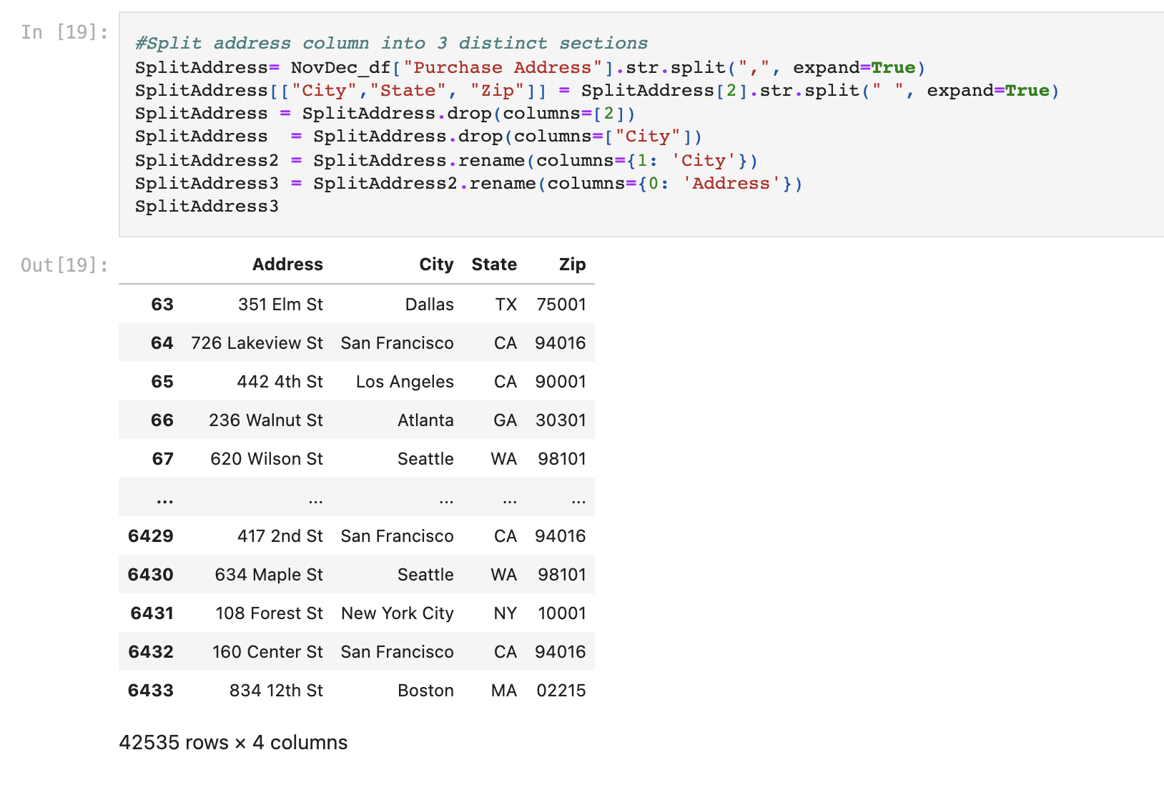
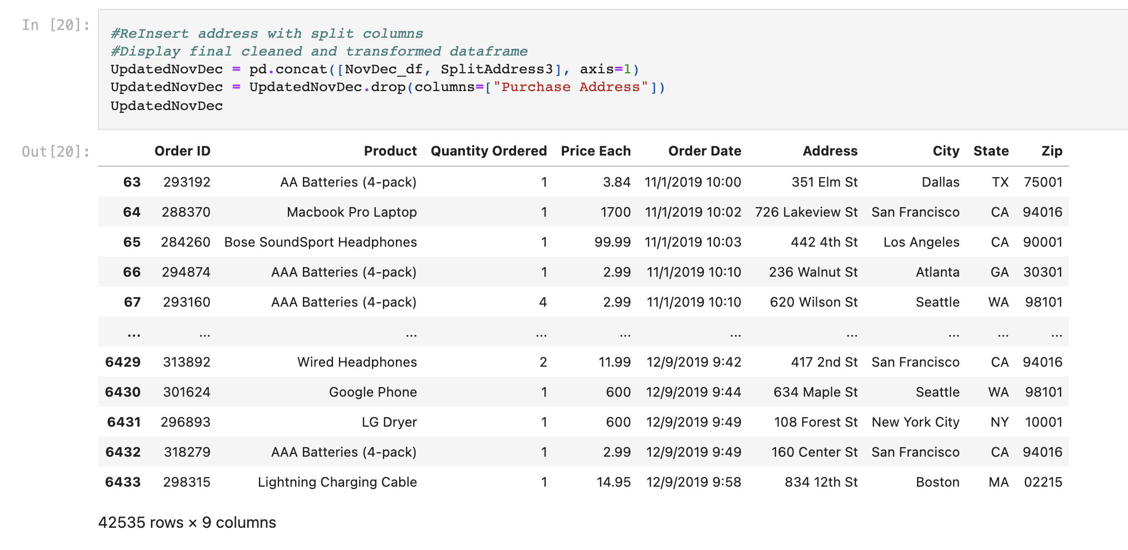
Holiday Shopping
We found two datasets for November and December Holiday Sales by area. Our team wanted to combine these so we could look at all of the sales for the Holiday Season. We joined the two CSV files together. Once sorted by date, we dropped all of the null values, blank and duplicate cells to create a clean data frame. The address column was then separated by a common delimiter into columns for address, city, state, and zip code.

Slide 4
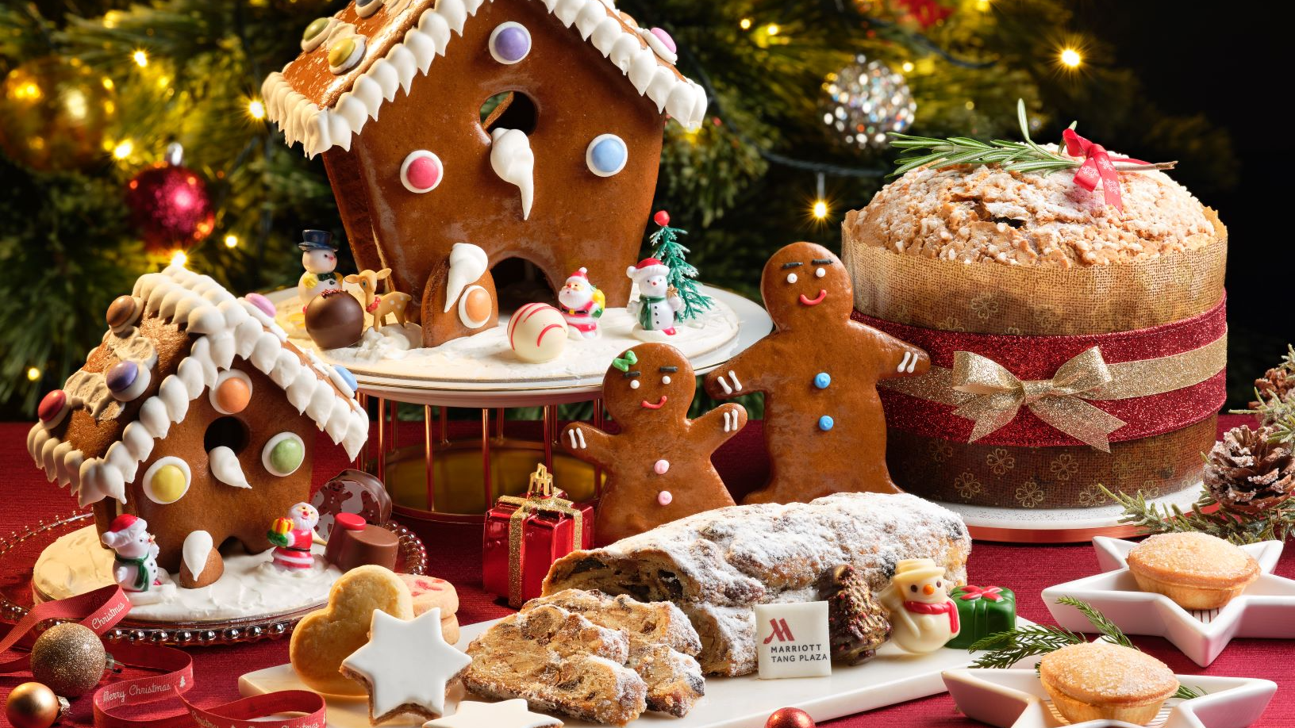
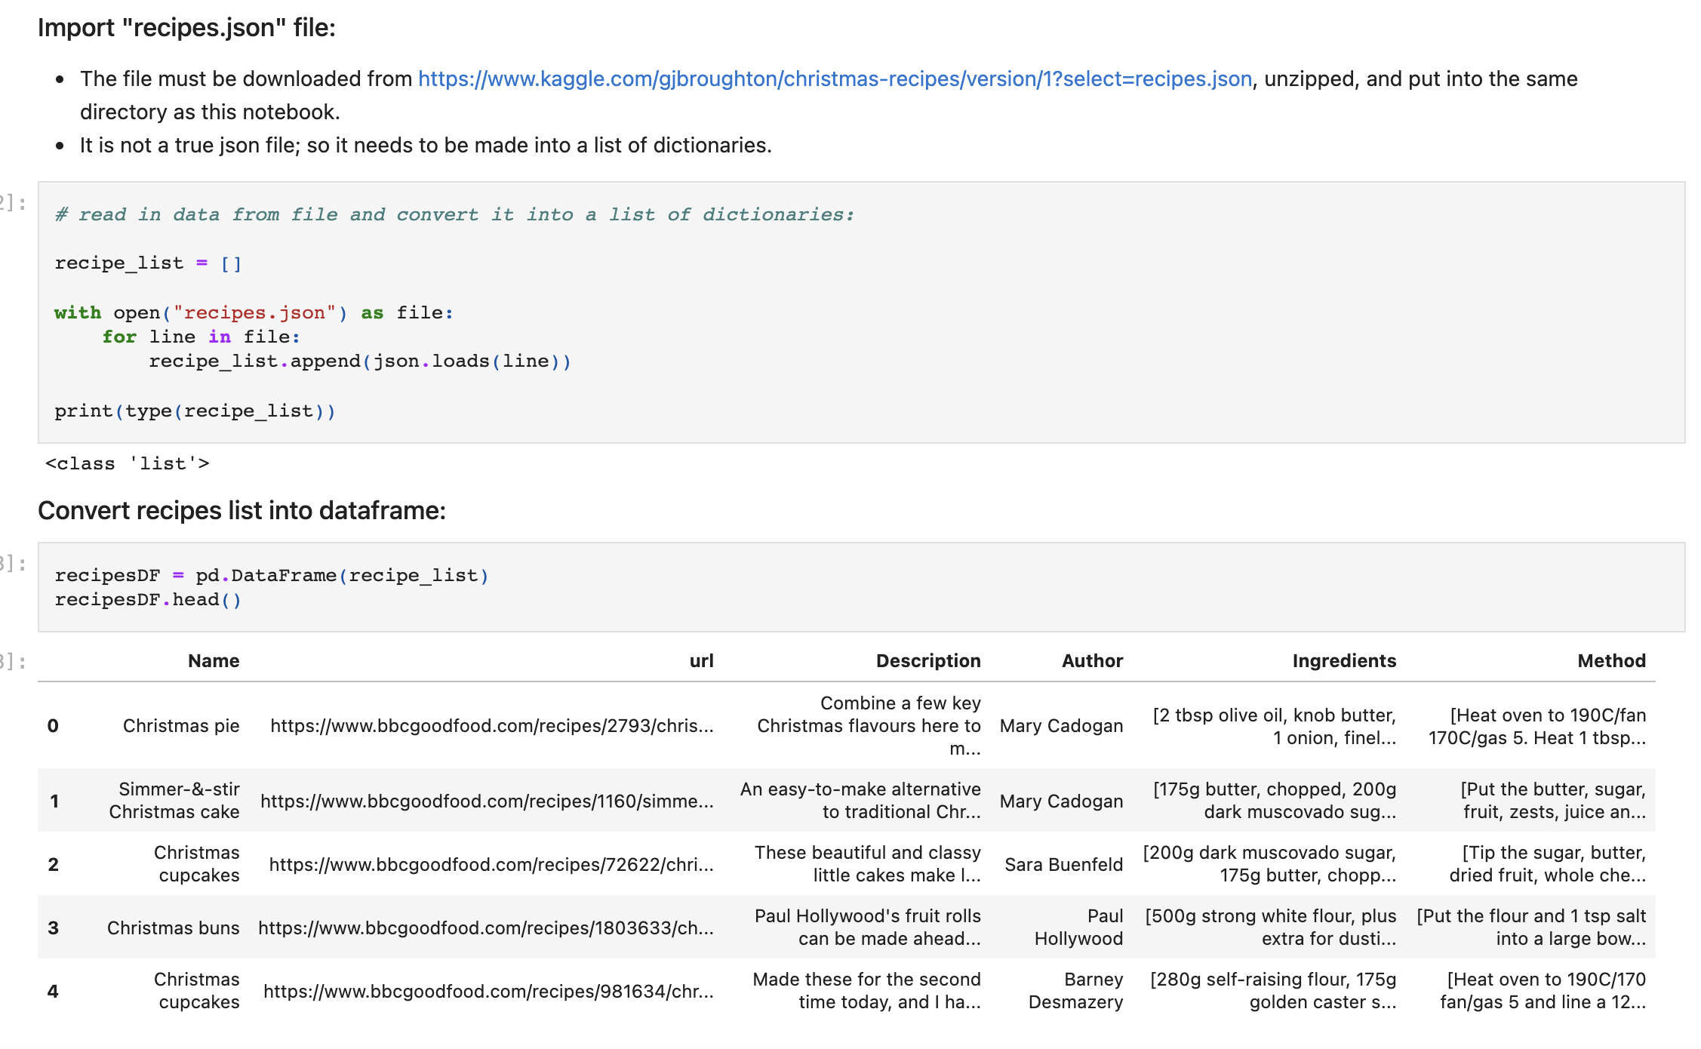
Food & Recipes
We found a JSON file that contained recipes that fit our criteria. The file wasn’t exactly in a JSON format, so we changed it into a true JSON. After we got the JSON in PANDAS we were able to upload into PostgresSQL.

Slide 5

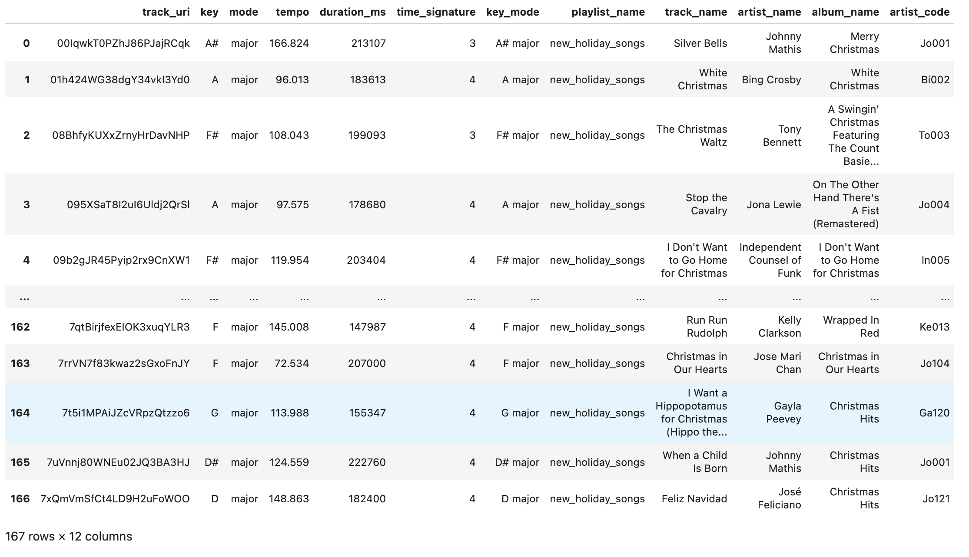
Christmas Songs
For the Christmas songs our group found a Billboard top 100
Christmas song long along with a Spotify database with Christmas songs. We dropped the unnecessary columns for both datasets. We took all the artist names from the Spotify dataset and made a unique ID code for each artist. We then merged the tables together using the unique identifiers with the Holiday song data from Billboard.

Slide 6

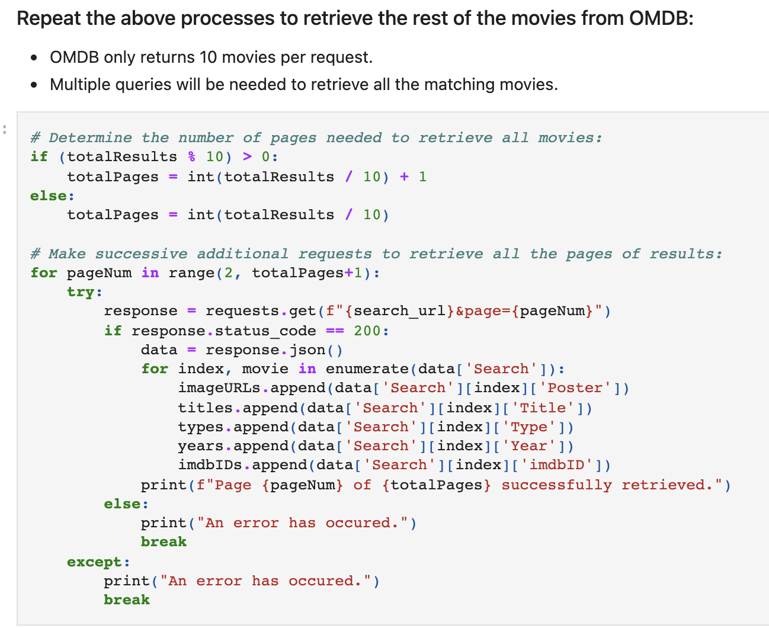
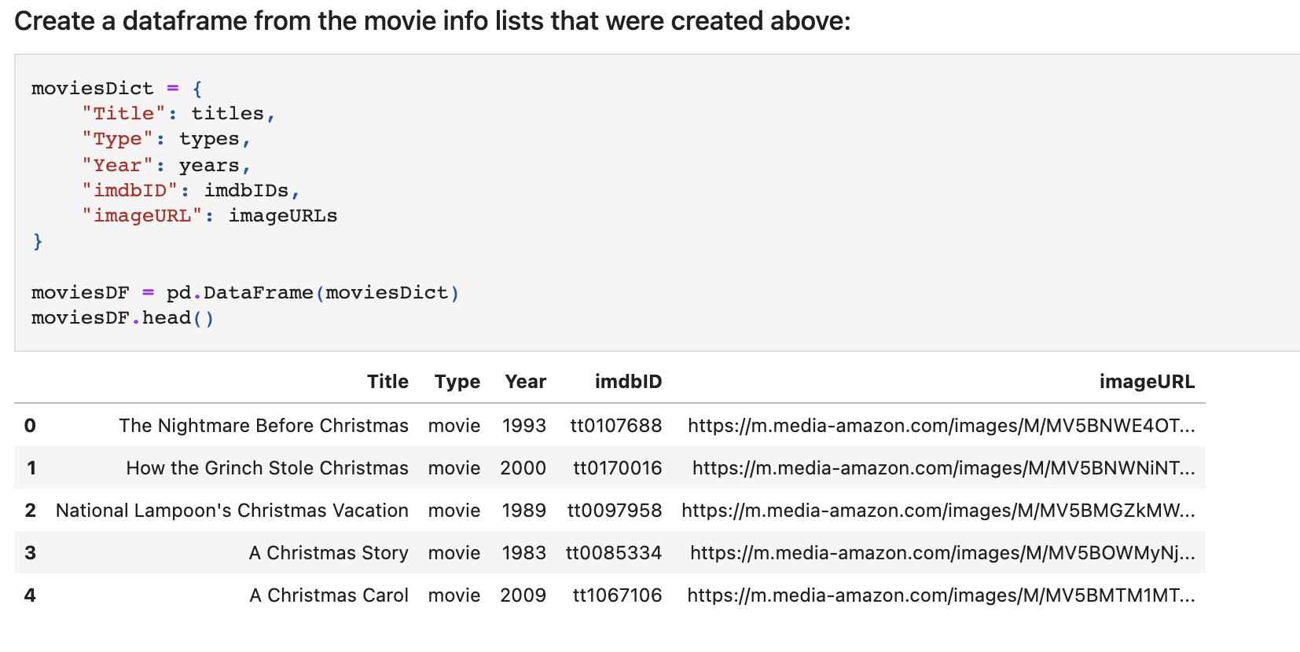
Christmas Movies
For this dataset we used the OMBD API. We ran a query to return all the movies that fell within the Christmas genre. Because OMDB only allows 10 results per query we had to figure out a way to run the results to get all the movies we were looking for. We ran a For loop to get all 484 results. Once this step was complete, we created a data frame to see all the results.

Slide 7

Conclusions and Limitations
This project taught us quite a bit. Some of our observations are listed below:
We wanted to analyze the data. It was hard not providing conclusions and simply just uploading the data.
Every dataset is different. We had to employ several different methods to get the final data frames that we would upload into PostgresSQL.
Sometimes when you analyze data you will find yourself looking for a commonality to combine two or more sets together.

Slide 8

Citations
https://www.kaggle.com/gjbroughton/christmas-recipes?select=recipes.json

Slide 9

Merry Christmas
and
Happy Holidays, Everyone!

